Slide 1



















PLATINUM
GOLD
🥪
☕
SILVER
STANDARD
☕
🎫

Slide 2
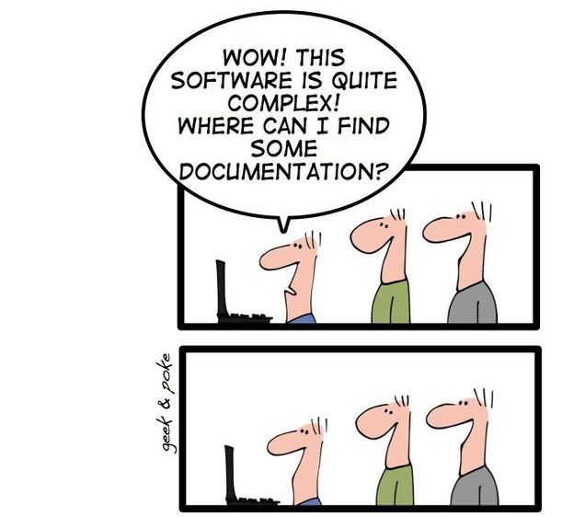
Documentation for Developers

Slide 3
Documentation for Developers

Slide 4
Developers
Do
Documentation
BRISBANE
https://geekandpoke.typepad.com/geekandpoke/2009/12/we-all-had-our-dreams.html

Slide 5


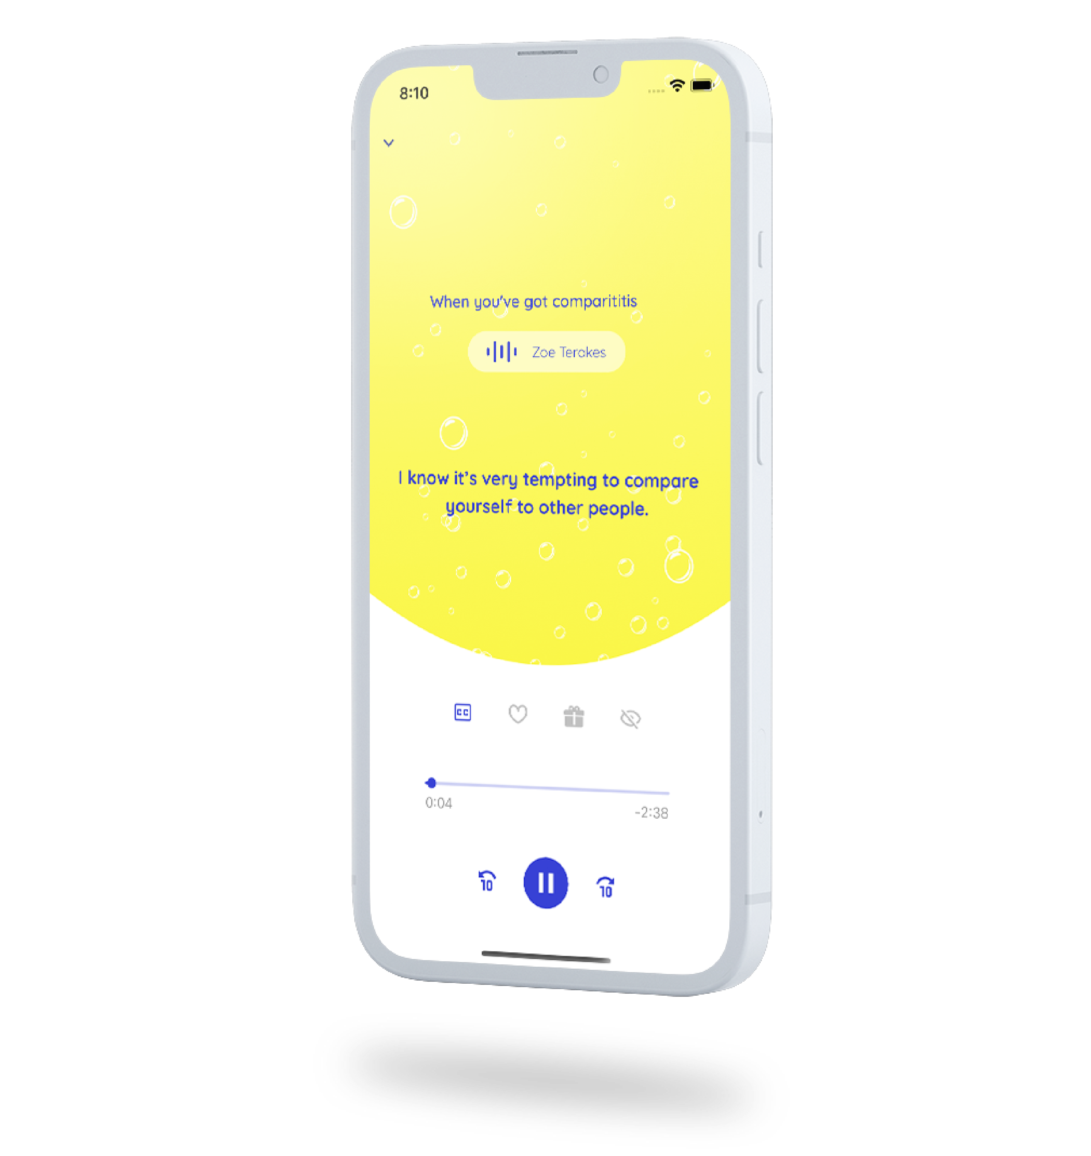
About Me
Currently
Principal Consultant & Practice Director
CTO
Previously
Various Enterprise, Startup and Freelance

Slide 6
Why do we document things?
Communicate complex systems easier
Reduce cognitive load
Developer On-boarding
Software and Solution Architecture
Architectural Guidelines and Principles
Decisions and rationale
Disaster recovery
Notes:
How can we get a new person up to speed as quickly as possible?

Slide 7
Why DON’T we document things?
Documentation is boring
Often requires special tooling, or licenses
Diagramming tools are often hard to version control
Perfect is the enemy of done

Slide 8
Traditional approach
Wikis, Confluence
Word Documents
Specialised tools
Visio
Draw.io
Paint
Illustration Tools

Slide 9
My ethos about documentation?

Slide 10
A possible solution?
Be pragmatic
Adopt “Documentation as Code”
Favour the separation of structure from presentation
Minimal requirement for extra tooling

Slide 11
Pros and cons
Version controllable / diffable
Simple to use/learn
Using a DSL vs just diagrams means there is context
Cross platform
Minimal tooling
Can generate images / pdf / ppt
Minimal licensing
Downside is the learning curve
Code sprawl
Harder to search & aggregate
Less accessible to non-tech folk

Slide 12
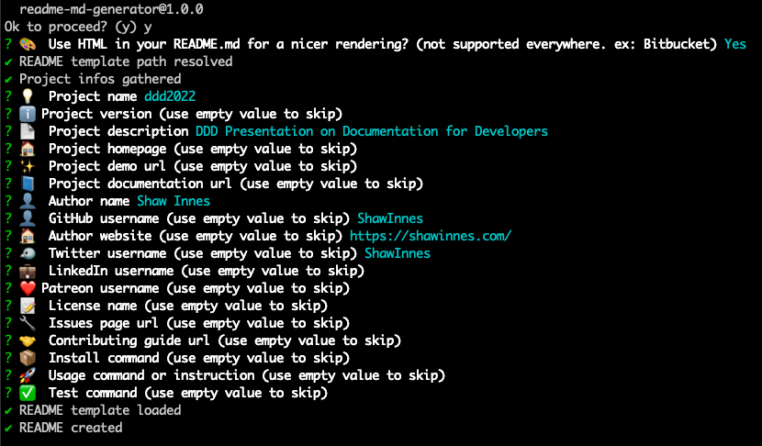
Markdown Readmes
A quick intro for onboarding
Use a template for consistency
Google for examples
Customise for your organization
readme-md-generator
https://github.com/kefranabg/readme-md-generator
Notes:
What’s the minimum amount of information someone needs to get up and running
We always look at READMEs as part of our interview process

Slide 13
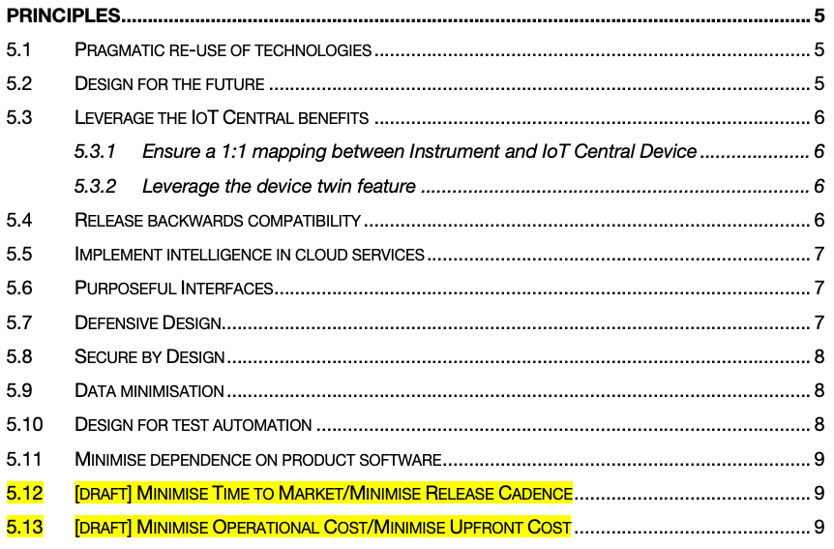
Architectural Guidance
Architecture Principles
Assumptions
Make it easier for developers to make decisions
Could this meeting have been a Principle?
Well-defined principles
Name: Succinct, easy to remember, and carries the essence of the rule (few words)
Statement: Unambiguous statement defining the rule (1 to 3 sentences)
Rationale: Why is this rule important, particularly in terms of business benefits.
Implications: Identifies explicitly how the rule affects the business, teams, etc.
Notes:
My pet hate is having to enlist the opinion of an architect every time you want to extend a solution
Can we come up with some guidelines and principles to help push decision making to the development teams?
Then if something isn’t covered in the architectural principles, consult an architect.

Slide 14
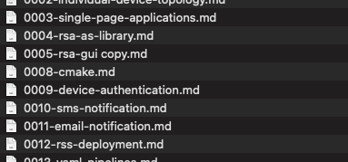
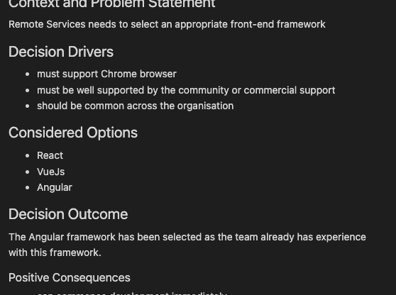
Tracking Decisions
Markdown Decision Records (MADR)
Context/Problem
Considered Options
Decision
Consequences

Slide 15
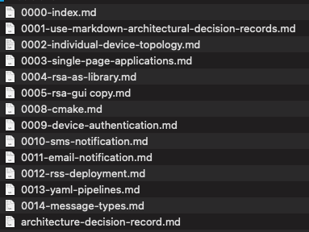
Tracking Decisions
Markdown Decision Records (MADR)
Context/Problem
Considered Options
Decision
Consequences

Slide 16
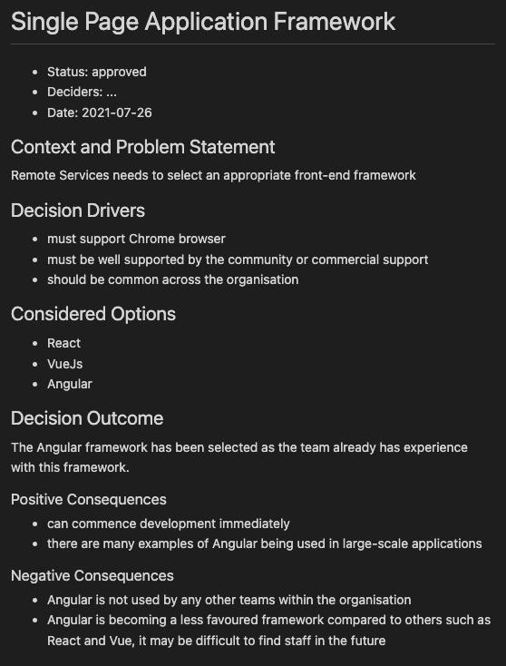
Tracking Decisions
Markdown Decision Records (MADR)
Context/Problem
Considered Options
Decision
Consequences

Slide 17
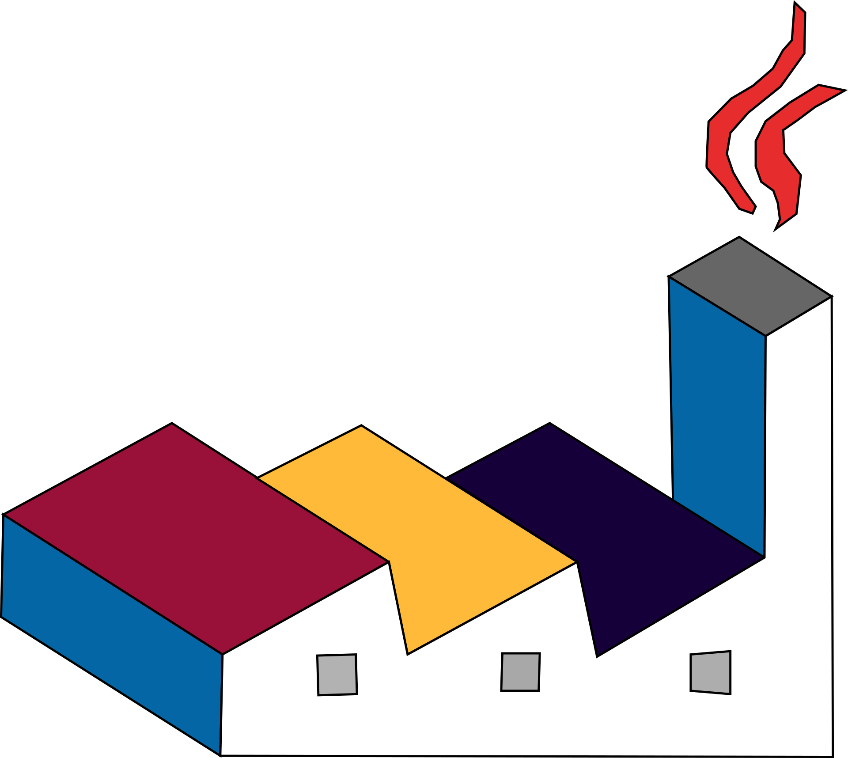
Diagramming - PlantUML
Text-based diagramming
Support for multiple diagram types
Sequence diagram
Class diagram
Activity diagram
Entity Relationship diagram
Extensible with Libraries
Azure, Kubernetes, AWS, C4…
Tooling
Visual Studio Code + Extensions
Supported by JetBrains and others also
Supported in various Markdown wikis
https://plantuml.com/
https://crashedmind.github.io/PlantUMLHitchhikersGuide/
https://github.com/plantuml/plantuml-stdlib

Slide 18
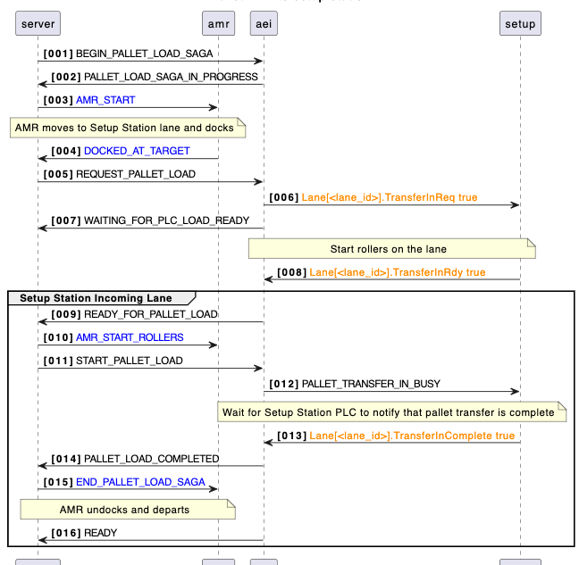
PlantUML Demo
Sequence Diagram
Notes:
01-plantuml-sequence.puml

Slide 19
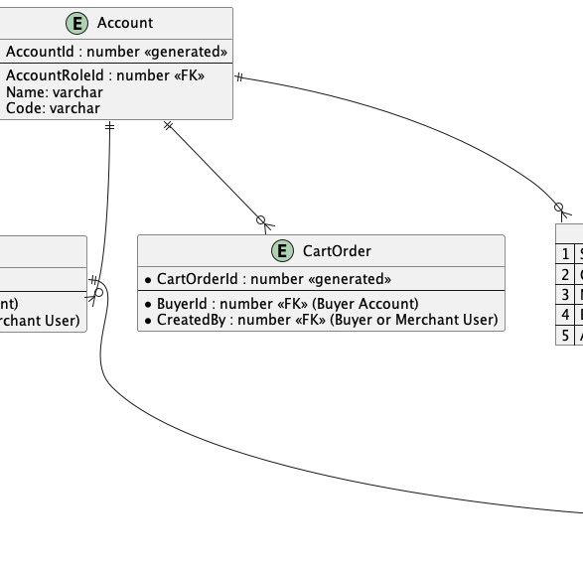
PlantUML Demo
Entity Relationship Diagram
Notes:
02-plantuml-erd.puml

Slide 20
C4 Model
Created by Simon Brown (see YOW 2022)
Helps avoid overly-complex diagrams
Context (level 1): system scope, users and other systems
Container (level 2): represents an application or a data store
web application, mobile app, serverless function, embedded device
Component (level 3): internals of a container
Code (level 4): class-level decomposition
https://c4model.com/
https://adrianvlupu.github.io/C4-Builder/
https://github.com/plantuml-stdlib/C4-PlantUML
https://c4model.com/review/
Notes:
I’ve found C4 to be really beneficial at stopping myself and others from trying to cram everything onto a single diagram

Slide 21
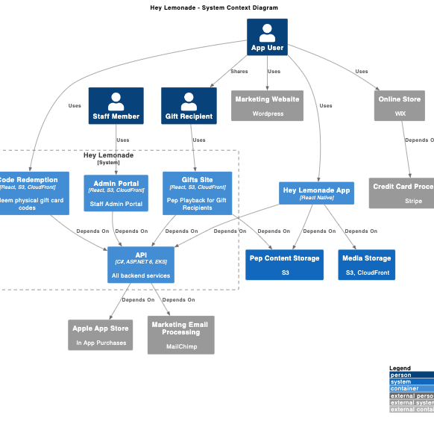
C4 Model Demo
Bad Context Diagram
Notes:
03-c4model-context-bad.puml

Slide 22
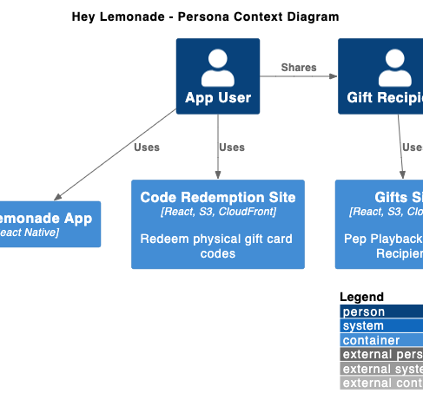
C4 Model Demo
Good Context Diagram
Notes:
04-c4model-context-good.puml

Slide 23
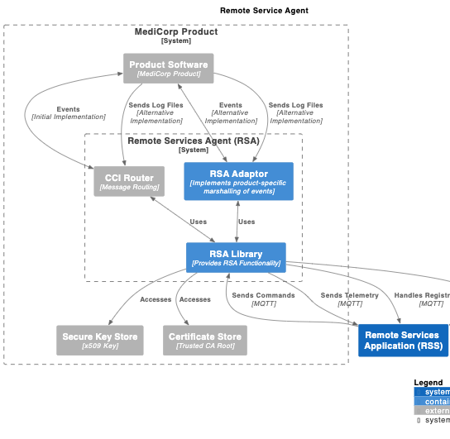
C4 Model & Markdown Demo
Context & Container Diagrams
Notes:
05-context.md
06-component.md

Slide 24

Bringing it all together
Roll your own scripts
Markdown front-matter for metadata
Output to PDF in CI/CD pipelines
Tools like C4 Builder
https://adrianvlupu.github.io/C4-Builder/
https://pandoc.org/
Notes:
https://docsfordevelopers.com/table-of-contents/

Slide 25

Structurizr
Tooling to extend on PlantUML & C4 & ADRs
More control over rendering
Linking between different elements
Model and element reuse
Team sharing
(Also by Simon Brown)
https://structurizr.org/
https://structurizr.com/
https://structurizr.com/help/decision-log

Slide 26
How do you encourage developers to document their code inline? So that code doco can be rendered in the build pipeline.
It’s not something I actively encourage, but it depends on the type of software you’re writing. As with most of the stuff I’ve presented here, be pragmatic.
Through the pull request process is a good way to ensure that code is documented, if required. I would suggest documenting code inline if the intent of the code can’t be clearly understood by a mid-level developer.
However, if you’re creating a library or API that is to be consumed by 3rd parties, then inline documentation might be more useful. In this case I’d look at using convention tests or some other process in your CI build to break the build if a developer adds new code without the expected documentation.

Slide 27
Can you recommend a good starting template for an Architectural Guidance doc?
Software Architecture for Developers – Simon Brown http://leanpub.com/software-architecture-for-developers
Creating Software with Modern Diagramming –Ashley Peacock https://pragprog.com/titles/apdiag/creating-software-with-modern-diagramming-techniques/
As much as I would hate to recommend TOGAF…
https://pubs.opengroup.org/architecture/togaf8-doc/arch/chap29.html

Slide 28
Any alternatives to PlantUML? Have you looked at mermaid?
Yep, I’ve used mermaid. It’s a good option because it seems to be natively supported by more wikis and github etc.
The reason I didn’t talk about mermaid much is because it’s a bit limited in functionality compared to PlantUML. Having said that, if it’s supported by your platforms then mermaid is a good option. It’s also relatively straight forward to move from mermaid to PlantUML later if you need the extended functionality.
From a documentation point of view, a couple of people suggested Asciidoc during the Q&A session. I haven’t looked into this heavily but I think it’s worth a look as well, especially for creating large-scale user documentation.
Another project I recently came across is kroki.io – it seems to be an amalgamation of a bunch of other text based documentation projects.

Slide 29
Any tools for exporting tables from Excel to markdown?
There’s actually a Visual Studio Code extension for that. If you just want to copy/paste tables this is a good option:
https://marketplace.visualstudio.com/items?itemNam
e=csholmq.excel-to-markdown-table
I’m not sure about what you’d do if you wanted to extract a table as part of a CI process though.

Slide 30
What would you recommend for BPMN?
Good question. I haven’t done a lot with BPMN.
When I did have to view some BPMN documents recently I used Visual Studio Code plugin to visualise the diagrams, but that’s about the extent of my experience unfortunately.
I know PlantUML doesn’t currently support it because there’s an open issue discussing this.

Slide 31
Can you do cloud infrastructure diagram? Also, can you add images (logos)?
Absolutely. There are a ton of PlantUML libraries for this:
https://github.com/plantuml-stdlib/Azure-PlantUML
https://github.com/awslabs/aws-icons-for-plantuml
https://github.com/dcasati/kubernetes-PlantUML
https://crashedmind.github.io/PlantUMLHitchhikersGuide/aws/aws.html

